Slide 1
5 MAGIC WORDS
WHY ARE THEY “MAGIC”?
From the Cambridge Dictionary
MAGIC-“Noun: A special and exciting quality that makes something seem different from ordinary things.”

Slide 2
Going to the THINKING gym!!!
Materials:
Sheet of paper
Pencil
Directions:
Fold paper into 4 sections
Each section is for a specific purpose
THINK OUT OF THE BOX!!!

Slide 3
IMAGINATION
IMAGINATION
The ability to form images in the mind, especially of things never seen or never experienced directly
An ability to think of ways to deal with difficulties or problems
“…is when you dream!” (4 year olds response)

Slide 4
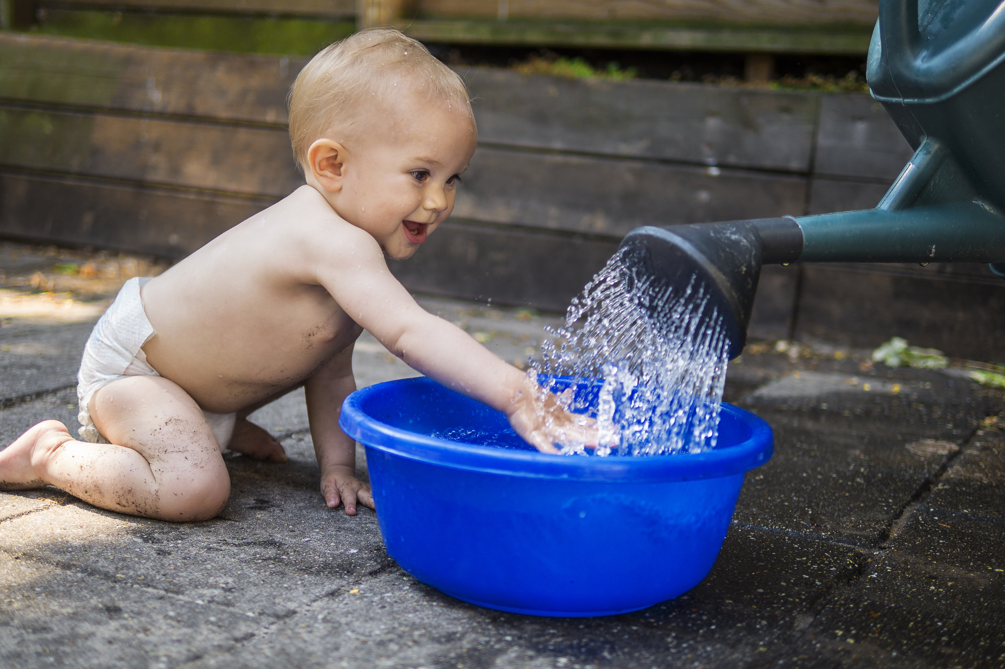
DISCOVERY
Finding or learning something new
The process of realizing something for the first time
The search for something new or unexpected
The recognition of somebody’s exceptional talent or beauty
“…I was digging in the sandbox and found a bug.” (4 year olds response)

Slide 5
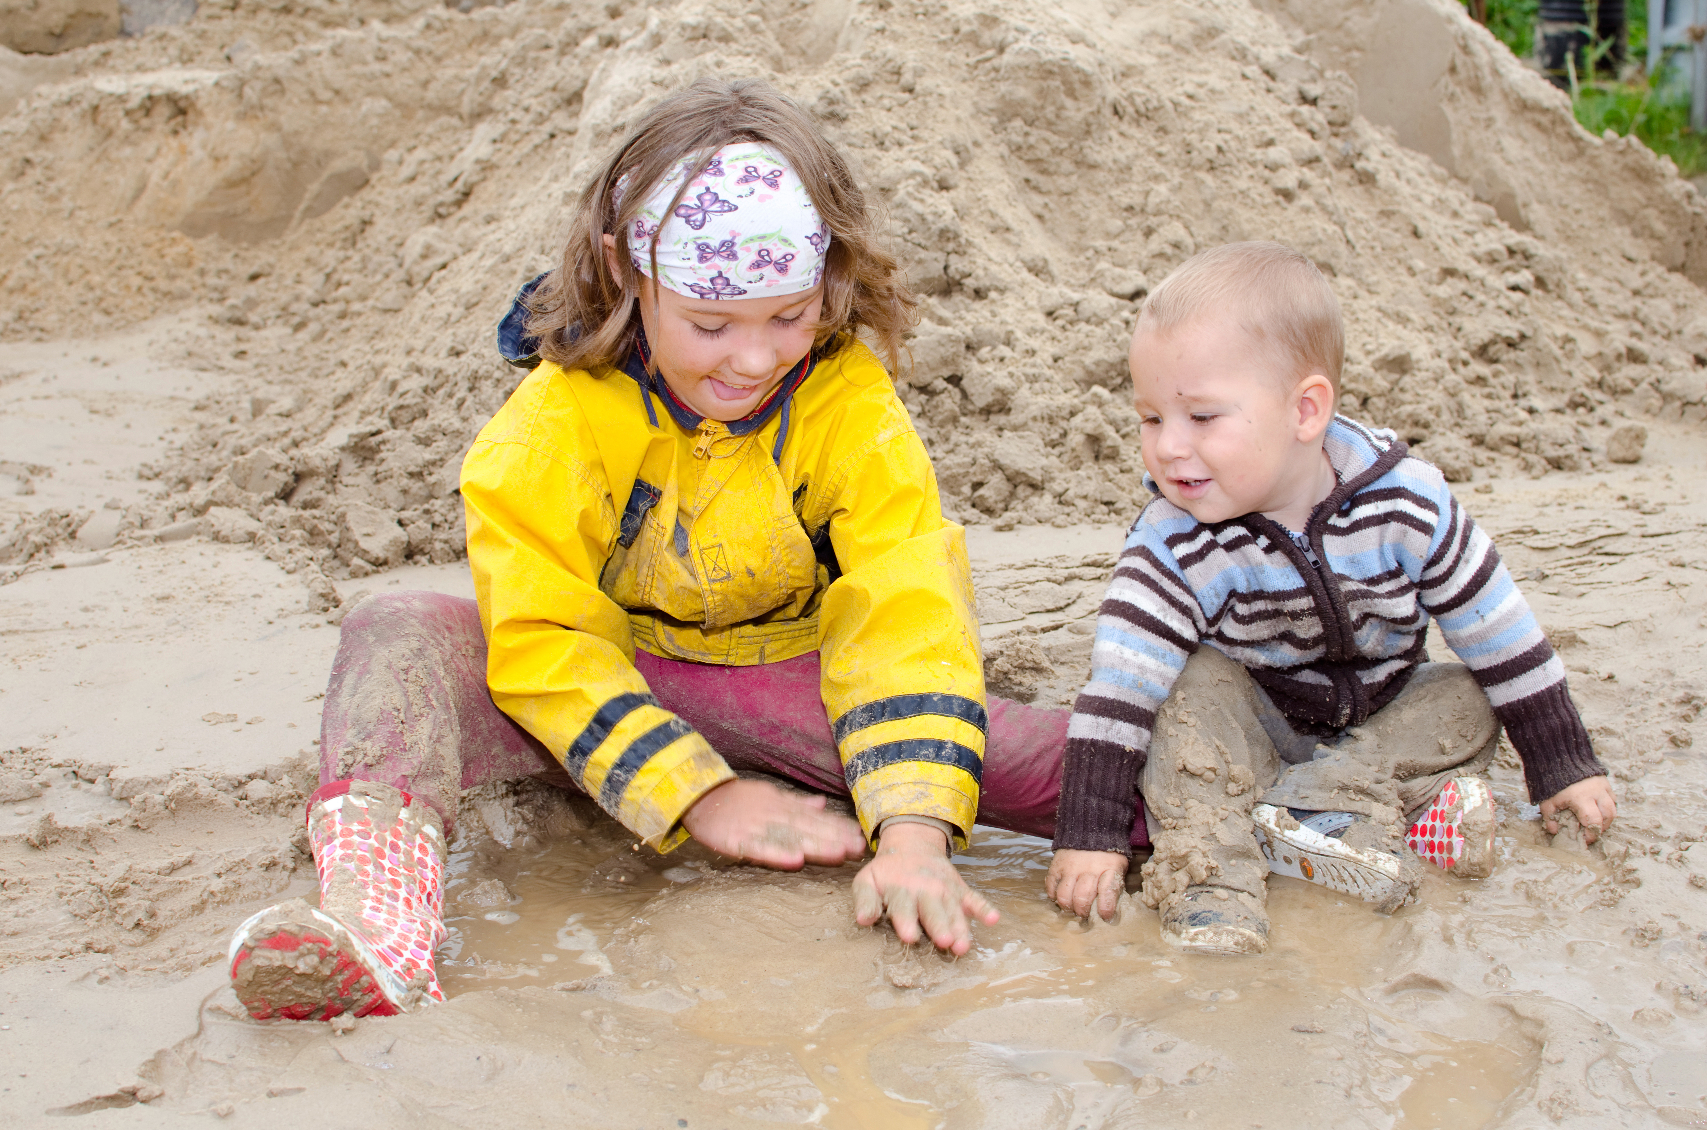
EXPLORATION
Digging deeper into a study of something.
“…using the magnets to see where they stick.” (4 year old response)

Slide 6
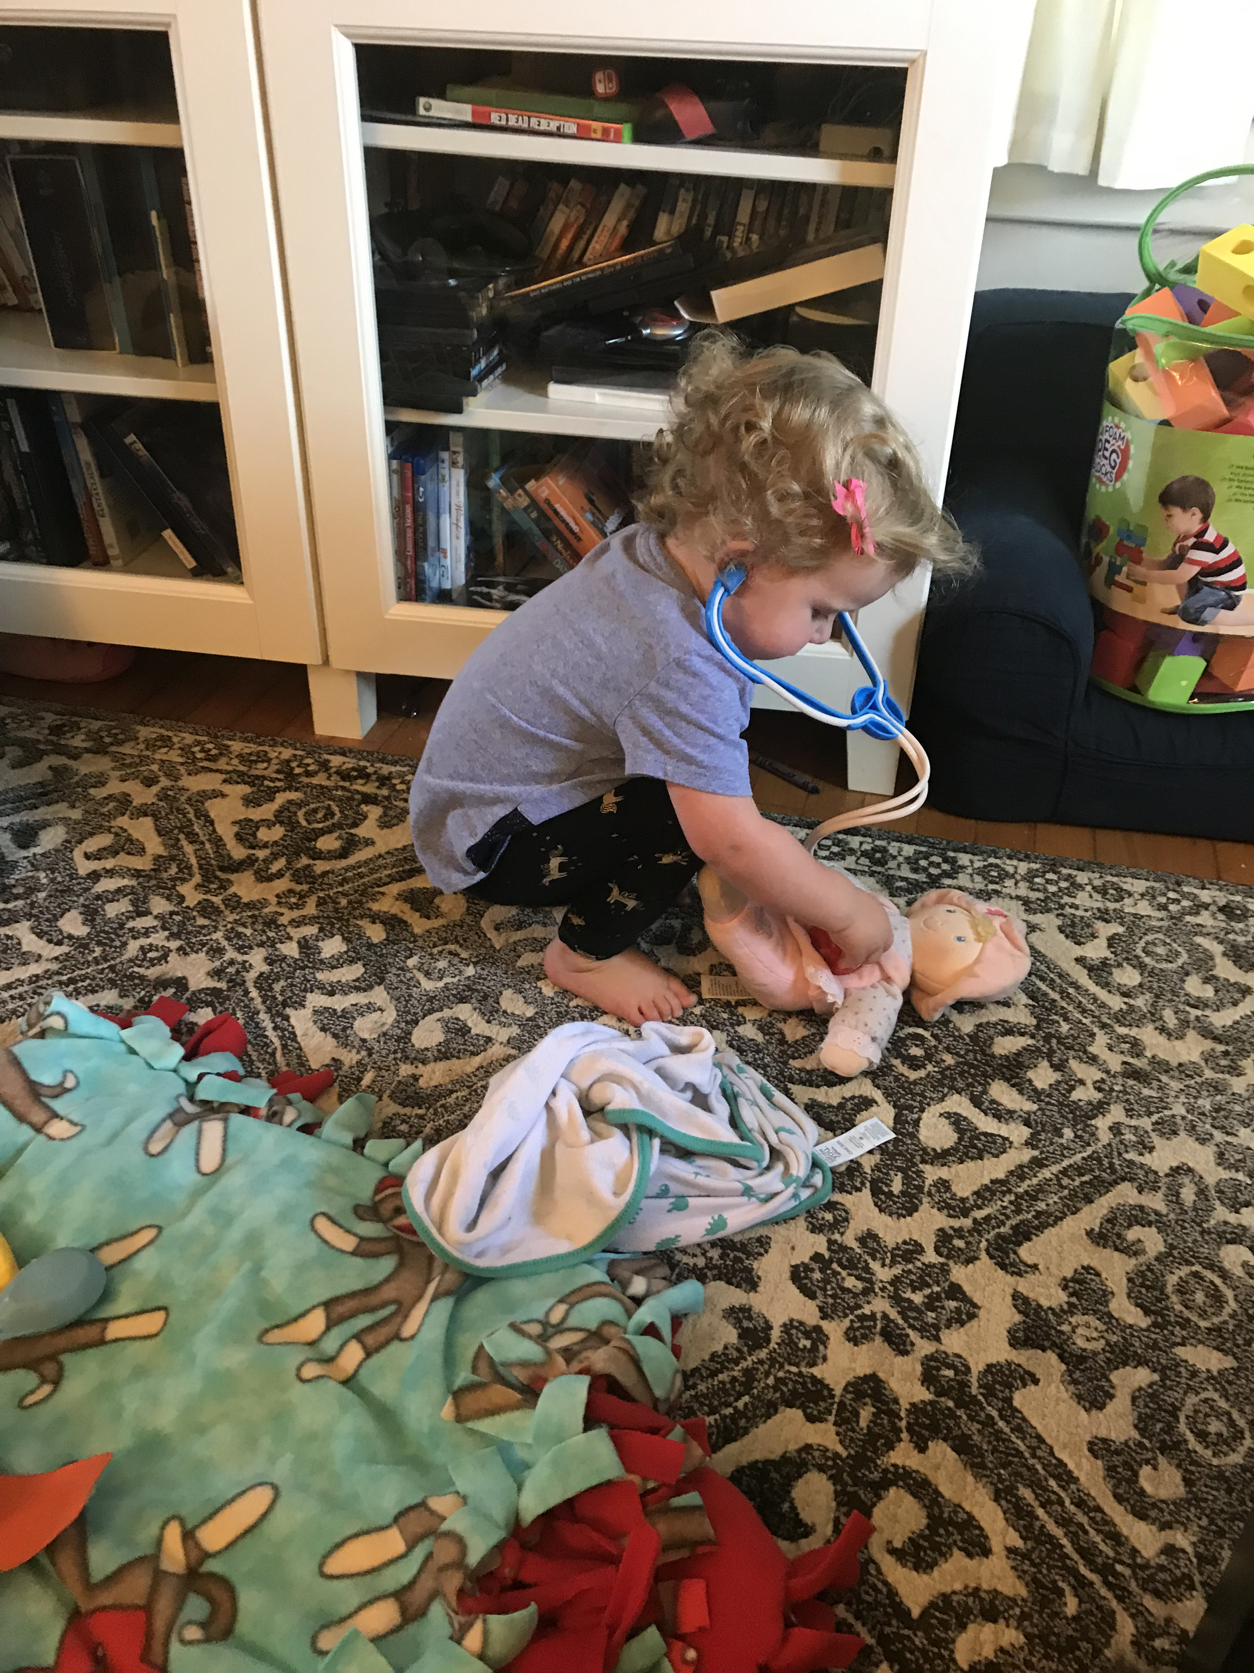
INVESTIGATION
Searching to find facts by inquiring about details after careful examination.
The scientific method that encourages inquiry.
“…..I felt the worm and it was smooth”! ( 4yr old response)

Slide 7
CREATIVITY
The ability to use your imagination to develop new and original ideas or things, especially in the artistic context.…
“…stuff we do that’s fun!” (3 year olds response)

Slide 8
KWHL
“E” KWHL
EXPERIENCES
inform
What we KNOW
Informs
What we WANT to know
informs
HOW we want to learn
Informs
knowing what we Learned

Slide 9
Types of Listening Skills

Slide 10
OPEN ENDED ?????’s
http://decal.ga.gov/documents/attachments/Questions_Children_Think.pdf
What (do you think will happen if….)
How do you think we can change that?
When do you think …..
Why do you think the sky gets dark at night?
Where do you think birds sleep at night? Why do you think that?

Slide 11
Looking at the OLD in a NEW way!
BLOP PAINTING
FINGER PRINTS, HAND PRINTS, WHATEVER PRINTS
CRUNCH PAINTING
MOVE EVERYTHING
CIRCLE STORY
REFLECT

Slide 12
What’s Happening? Where are we going?
Mix and Stir!
How will it grow???
Bear Hunt!!
Who started it?

Slide 13
Explore your space!
Get BIG-
Get small
Whacky Walking
Guided Imagery
Story

Slide 14
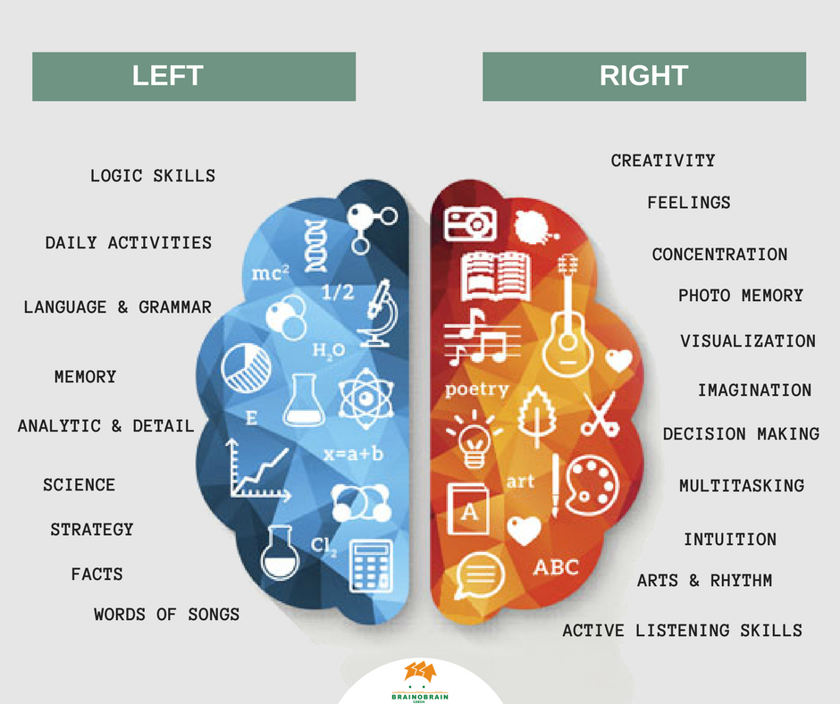
HEAD, HEART, SOUL
Thinking- Feeling- Believing

Slide 15
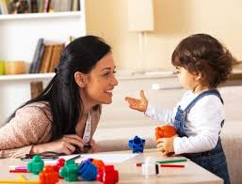
BELIEVE

Slide 16
THINKING, FEELING, BELIEVING

