Slide 1
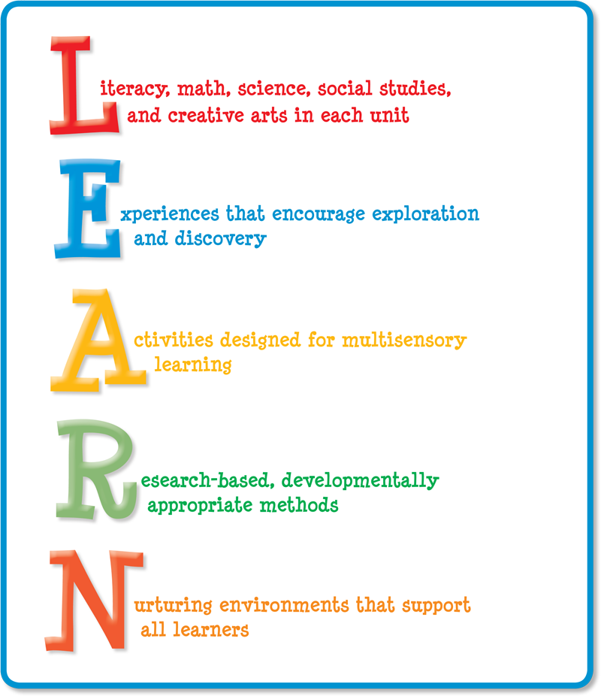

Slide 2
What else can this quote represent in our educational system?
“I think growing up, people want to put you in a box and label you quite often, just because it's kind of easier, I guess.”
–Mabel (Spanish Musician)

Slide 3
Exercise your Brain

Slide 4
Draw something without lifting your pen.
(Can lines have feelings!?)
Squiggles (and Wiggles!)
Balloon Blast

Slide 5
HMMMMMM…Is this even possible?

Slide 6
Step out of your FEAR ZONE, but go slowly…
“When you broaden the little box that you’ve been living (teaching) in for so long, it can be very uncomfortable at first”
—Author Banks (American Musician)

Slide 7
“OE”KWHL
OPPORTUNITIES and EXPERIENCES inform…
What we KNOW
What we WANT to know
HOW we want to learn
Knowing what we LEARNED

Slide 8
HEAD, HEART, SOUL Thinking—Feeling—Believing

Slide 9
Open-ended Questions
What (do you think will happen if…)?
How do you think we can change that?
When do you think…
Why do you think the sky gets dark at night?
Where do you think birds sleep at night?
Why do you think that?
http://decal.ga.gov/documents/attachments/Questions_Children_Think.pdf

Slide 10
THINK about what is IN your Box
Literacy: 3 strategies you already use.
Math: 3 strategies you already use.
Art: 3 strategies you already use.
Small motor: 3 strategies you already use.

Slide 11
What do you mean by “Innovative Thinking”?
My simple definition of innovation is “doing something new, or doing something old in a new way.”
By extension, the definition of innovative thinking would be, “to think up something new, or to think about something old in a new way.”
dinghappens.com

Slide 12
Why Do New Ideas Matter?
Might your NEW and INNOVATIVE ideas ‘cost’ something? Will you need more materials to purchase or construct?
Always ask yourself “WHY am I doing what I’m doing?”
What is the learning goal?
Is that goal being accomplished? (and if FUN is the answer to any of the questions…That’s OK!)

Slide 13
We are ALL “in the box” But, do you want to get out?
THINKING and PLANNING “OUT OF THE BOX”
Before we can think “out of the box,” we need to know what’s IN the box.
“INSIDE” the box:
Write the activities that you already use to support the following curriculum areas: MATH, LITERACY, FINE MOTOR, ART.
Attach those to the INSIDE of the box
Thinking is the key!

Slide 14
Now, Look OUTSIDE the Box
“OUTSIDE” the box:
Write the ideas that are new and innovative that you haven’t done before, or you can do differently to support those curriculum areas (MATH, LITERACY, FINE MOTOR, ART).
We may want to think outside the box, but we really can’t unless we examine and understand what has already been done. We need to SUPPORT the box that exists, and also ADD new ideas.

Slide 15
Think about new and innovative ideas that you haven’t tried before. Do these ideas support your curriculum and learning goals for the children in this school and in your classroom?

Slide 16
It’s Not Just Numbers
Pre-Mathematics Concepts and Skills
MATH for Life

Slide 17
MATHeMATICS
Mathematics is the study of numbers, shapes, and patterns
Math students learn to identify and compare objects by size. They will measure and weigh themselves and be introduced to the concepts of volume, length, and weight. Though they are very young, preschool math students are able to use proper vocabulary to describe quantity, length, and weight.

Slide 18
MATH CONCEPTS 16 of the basic preschool math concepts are:
Observation.
Problem Solving
Language
One-to-One Correspondence
Number Sense
Shapes
Spatial Sense
Sets and Classifying
Ordering
Comparing
Patterning
Counting
Measurement
Parts and Wholes
Numbers and Symbols
Graphing
https://www.preschool-plan-it.com › preschool-math-concepts

