Slide 1
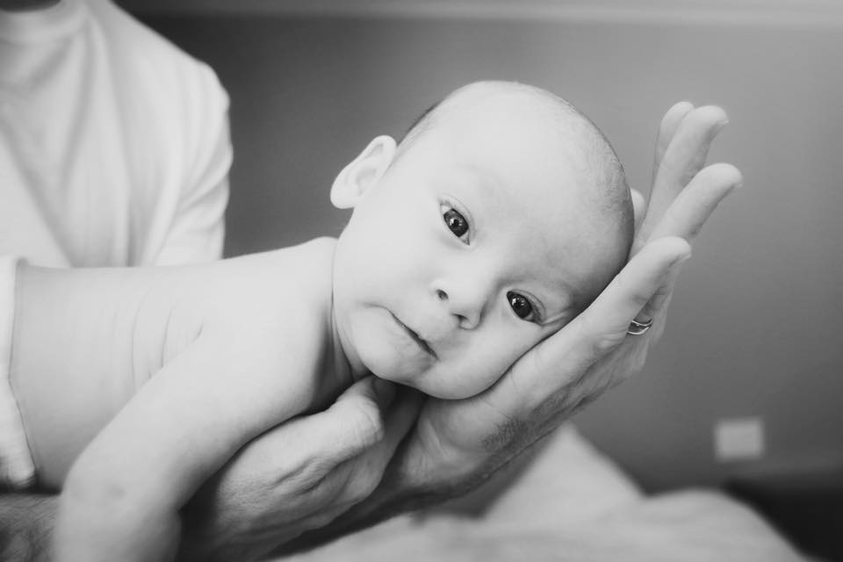
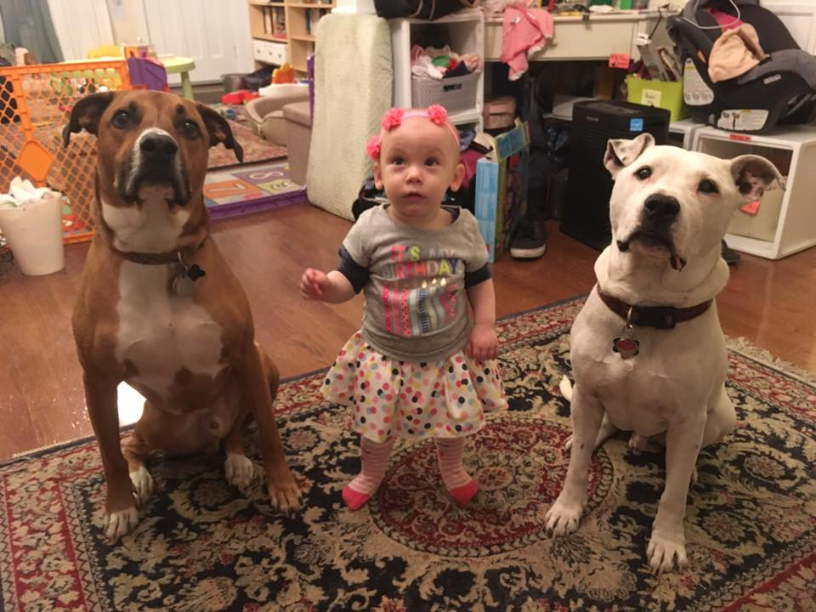
Welcome!

Slide 2
J.O.Y To Every Starfish
We can all make a difference!
Liz Kendall
Educational Consultant

Slide 3
Consider…
WHO are we?
WHAT can we offer children and families?
HOW can we best become facilitators of caring and education for every child in our classroom?

Slide 4
J.O.Y.
Just Offer Yourself

Slide 5
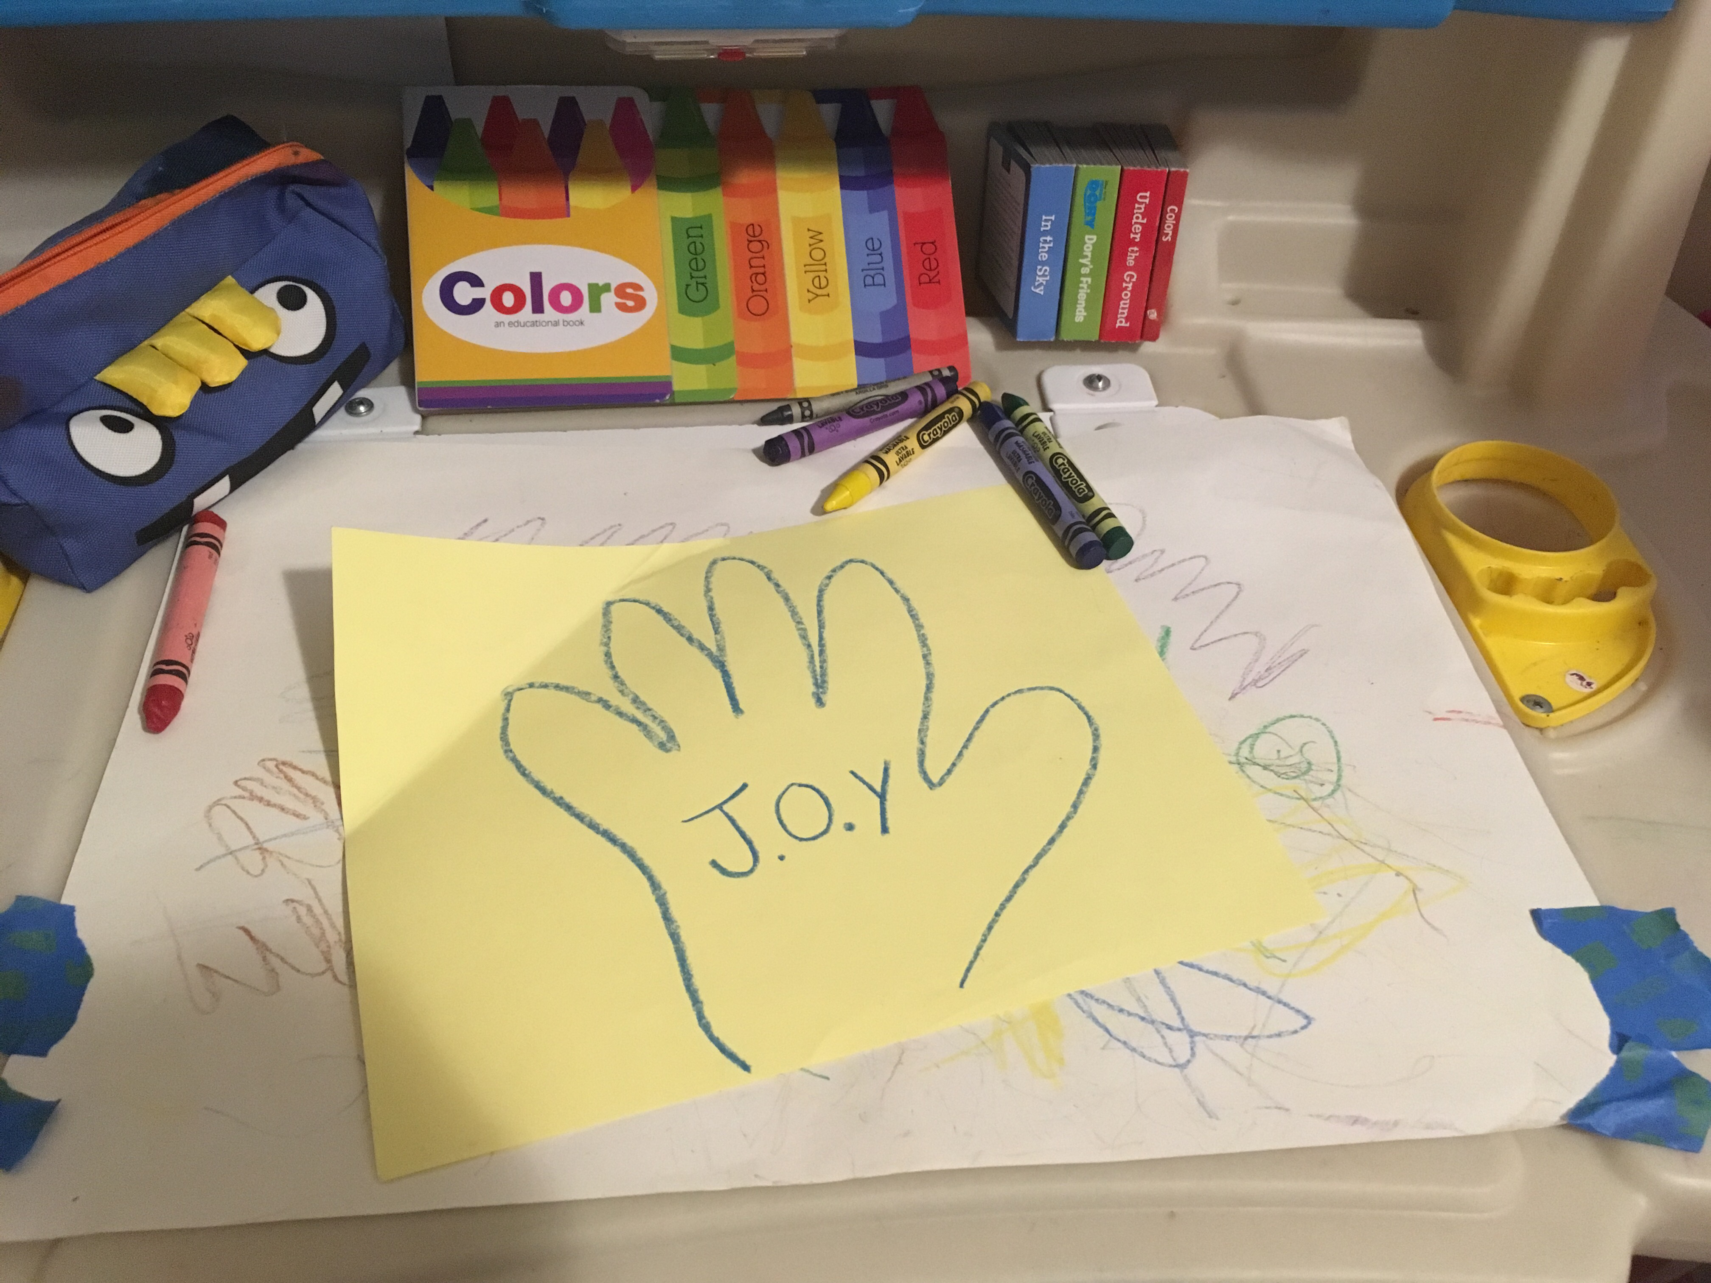
J.O.Y
“I can offer my ______________”

Slide 6
Letters and Words
D.A.P
K.W.H.L
P.C.C.C
Developmentally Appropriate Practice
Know/Want/How/Learn
Parent and Community Collaboration and Communication

Slide 7
IMPORTANT:
Be so proud of what you do!

Slide 8
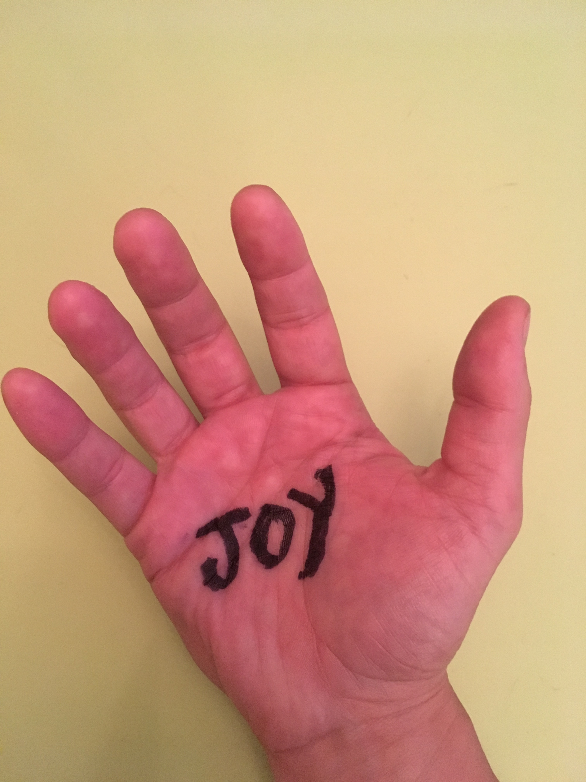
You have the most important job in the world!
and the key to that JOY of teaching and
learning is, as it always has been,
right in the palm of your hand !

Slide 9
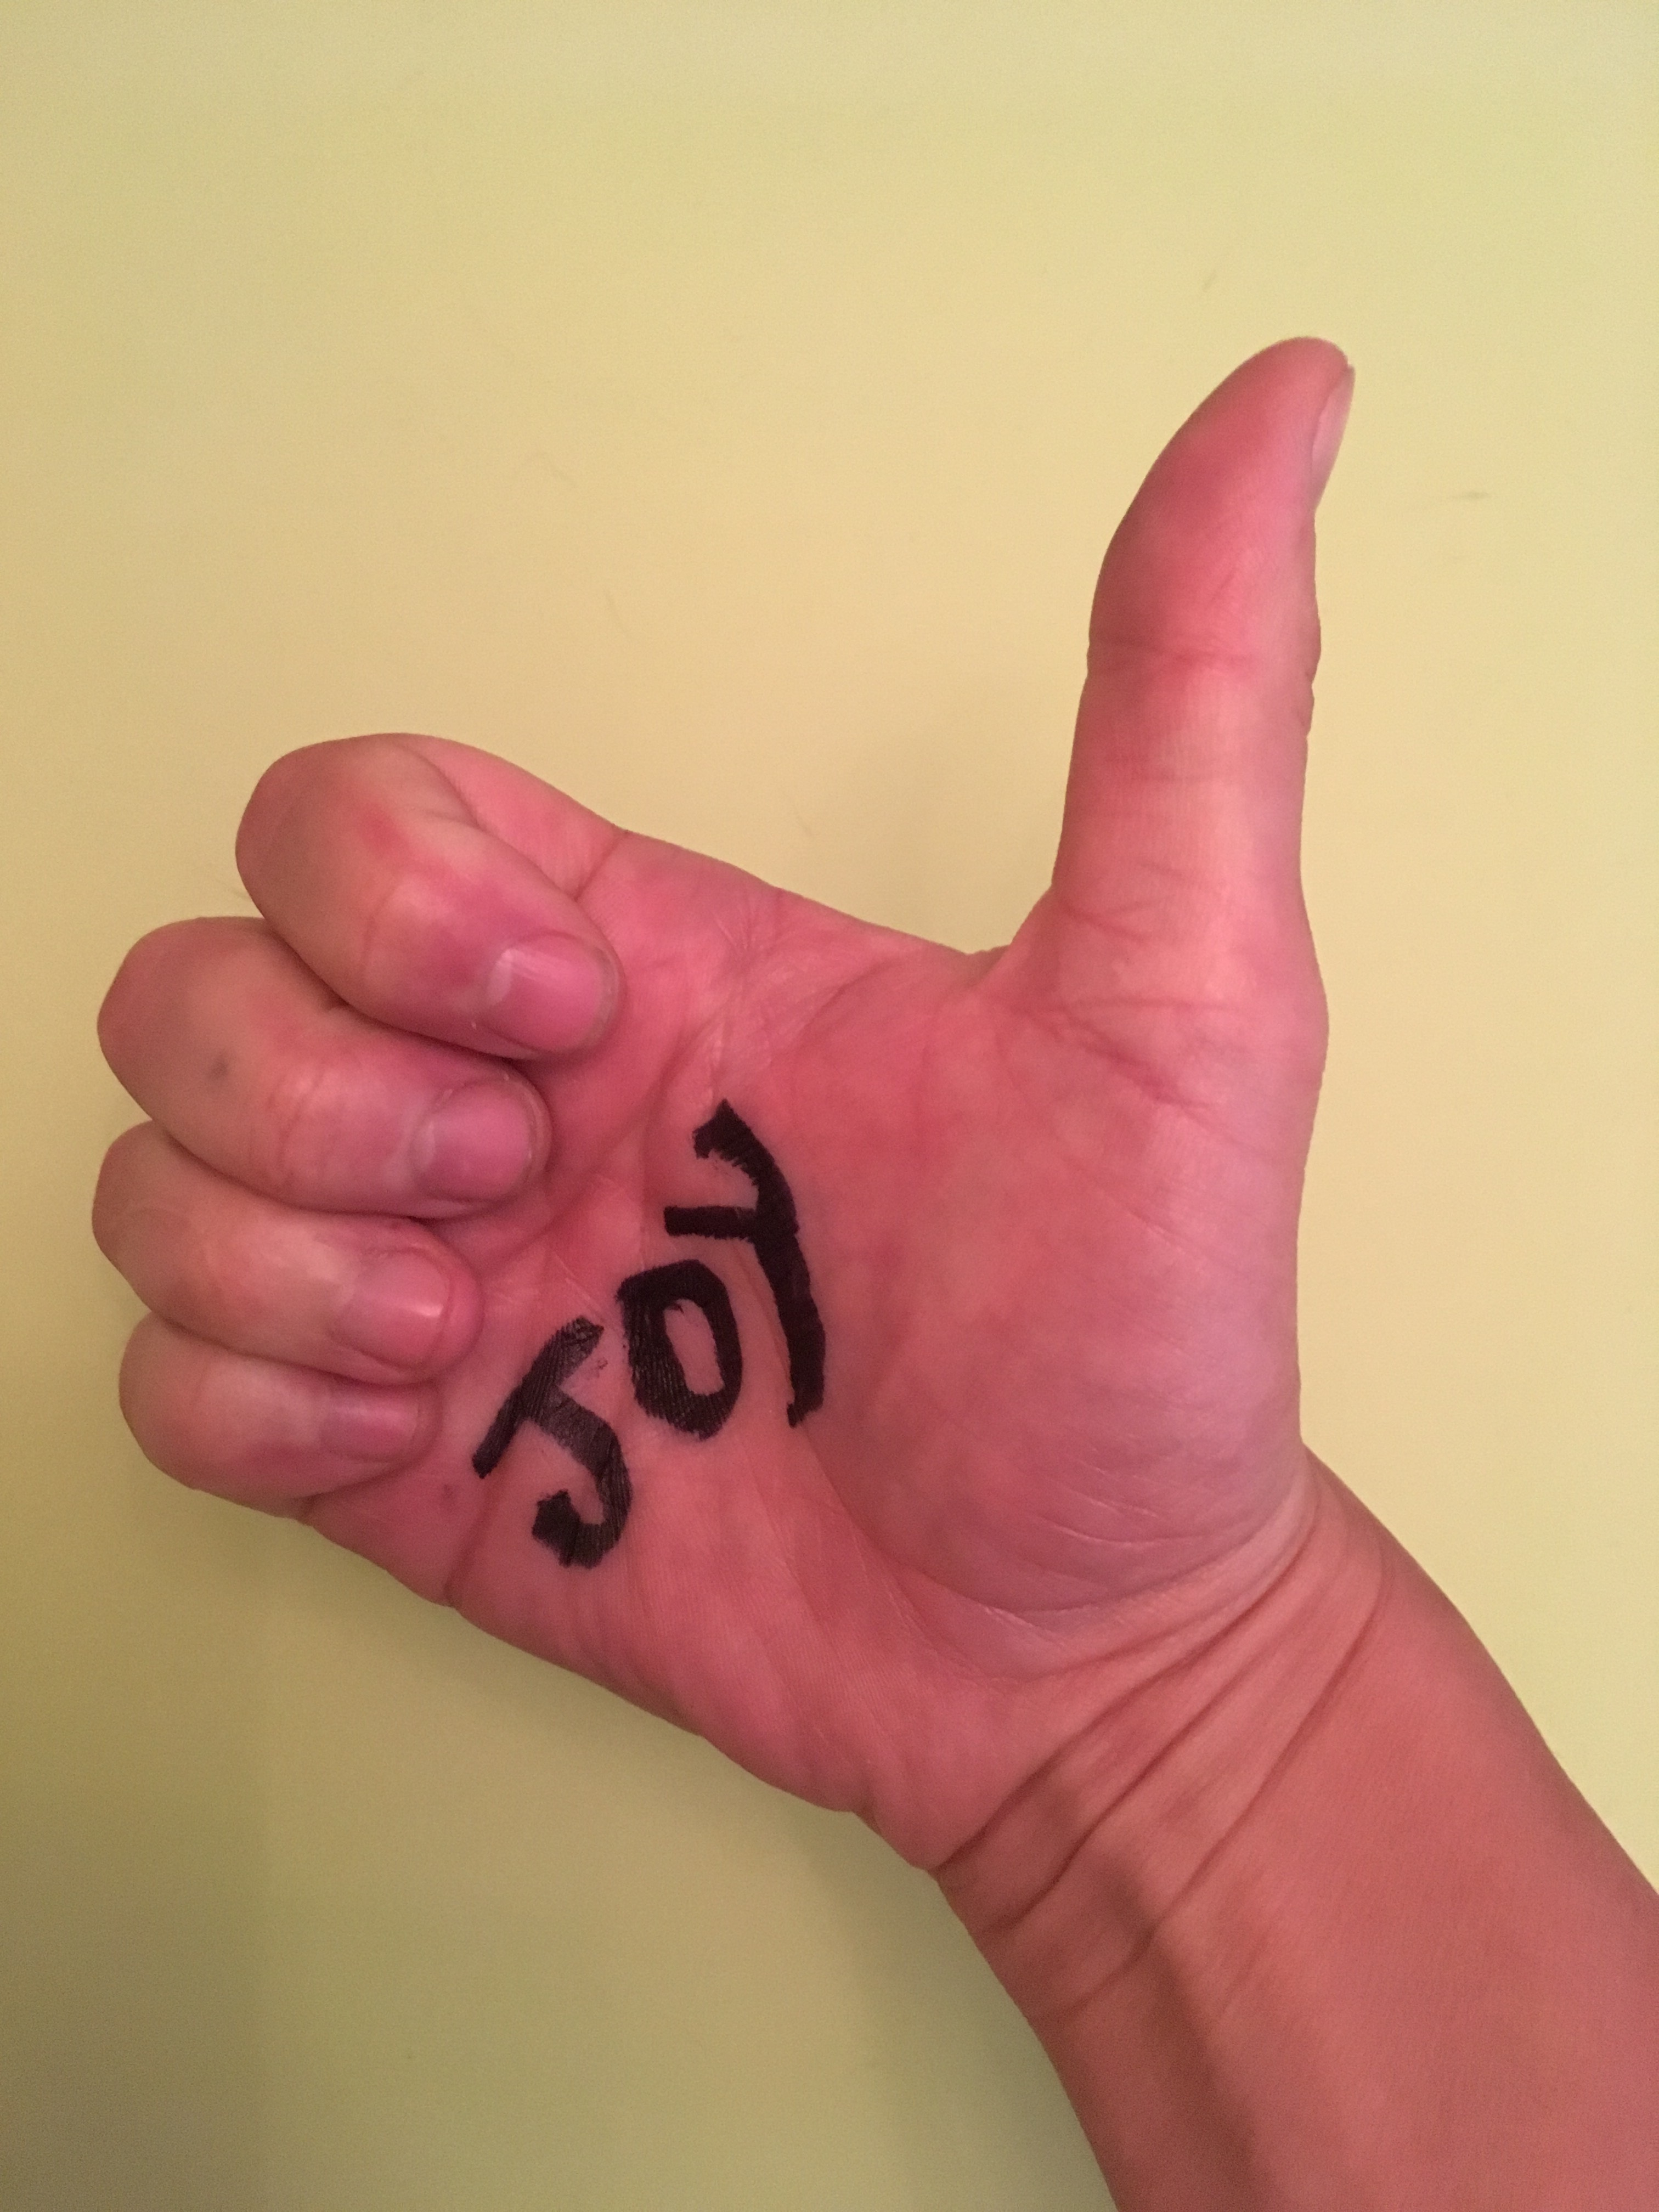
Thank you!
Feel free to contact me:
Liz Kendall
Educational Consultant
Email: lizsearleskendall@gmail.com

